Slide 1

Postgraduate studies –
Oil Business during the gas revolution
Robert Uberman
MBA Class
24th of April, 2015

Slide 2
Agenda
Overall view
Oil industry converted into oil & gas industry
Dynamics of technology shifts
NLG, LNG, LPG
GTL

Slide 3
Overall View
Refining as a mature business
Downstream as a poor cousin of upstream
Complexity of the refining business – joint product issue
Refining as an energy consumer

Slide 4
Falling demand for oil based products
Steve Cooper, „Crude Oil in Europe: Production, Trade and Refining Outllok”, WoodMckenzie, London, 2013, p. 14.

Slide 5
Evolution of the European demand side – cutting on edges
„Oil refining EU in 2020, with perspectives to 2030”, Concawe Report 1/2013, p. 21.

Slide 6
Evolution of the European demand side – gasoline to diesel
„Oil refining EU in 2020, with perspectives to 2030”, Concawe Report 1/2013, p. 19.

Slide 7
Evolution of the European demand side – gasoline to diesel
„The evolution of oil refining in Europe”, Concawe Review, vol. 22/1, 2013, p. 32.

Slide 8
Evolution of the European demand side – Fuel Quality
„The evolution of oil refining in Europe”, Concawe Review, vol. 22/1, 2013, p. 33.

Slide 9
Evolution of the crude supply around europe
Steve Cooper, „Crude Oil in Europe: Production, Trade and Refining Outllok”, WoodMckenzie, London, 2013, p. 12.

Slide 10
the European refineries – evolution of capacity
„The evolution of oil refining in Europe”, Concawe Review, vol. 22/1, 2013, p. 34.

Slide 11
refineries as energy consumers
„EU Refinery Energy Systems and Efficiency”, Concawe report no 3/2012, p. 4.

Slide 12
Natural gas as a key external energy source for refineries
„EU Refinery Energy Systems and Efficiency”, Concawe report no 3/2012, p. 11.

Slide 13
Conclusions
Refining in Europe - a mature business with declining demand
Key pressures, beyond falling demand:
  Diesel/Gasoline ratio forcing conversion up
  growing energy costs pushing conversion costs up
  both driven by EU policies
Majors leaving the business
Independents too weak to hold pressure
NOCs ready to step in

Slide 14
Oil business converted into “O&G”
Natural gas technical challenges
Gas based market products
Oil & gas majors

Slide 15
Attractiveness of Natural gas vs Crude Oil
It is more difficult to bring to markets:
  Through more complex logistic systems (Kandyoti, 2012)
  Through conversion to LNG, LPG or GTL
Deposits are more dispersed and “safe” countries possess bigger share in reserves

Slide 16
Expansion of oil business into gas
Five Winds International 2004: Gas to liquids. Life cycle assessment synthesis report. page. 13

Slide 17
Logistic is the key issue

Slide 18
Oil & Gas majors
Natural gas share in Major’s reserves is growing (Bain 2012):

Slide 19
Gas takeovers surpassing oil takeovers
Mega buyouts now regard natural gas: Exxon buying XTO Energy for 41 bn USD (2009/2010) and Shell to make 70 bn USD bid for British Gas (2015). The former was driven by shale gas, the latter by LNG
The purchase of BG is also a reminder that the oil majors are really oil and natural gas majors. BG will give Shell major LNG positions in Australia, and to a lesser extent in East Africa. By 2018, Shell will have twice the liquefaction capacity as ExxonMobil. Oilprice Newsletter, 2015.04.11

Slide 20
Dynamics of technology shifts
Innovation in Upstream
Breakthrough downstream innovations
Research & Development
Oil is natural but money made on it are anthropogenic

Slide 21
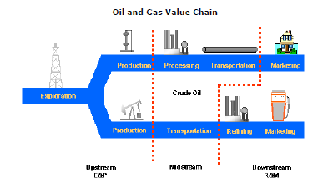
At first glance oil is a very simple business (…)
It’s, after all, about converting crude in a field into a fuel in an engine.

Slide 22
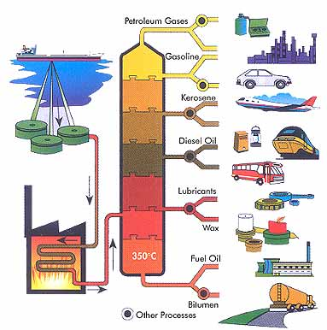
(…) But more deeper insight reviles some complexity (…)

Slide 23
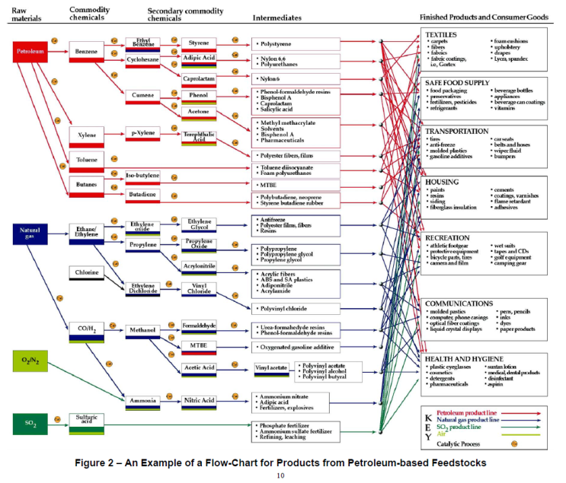
(…) Continuing down to that level
http://denmarkusmgreentour.wordpress.com/page/2/

Slide 24
R&D expenditures of Oil & Gas industry
http://www.oilgaspost.com/2013/05/21/top-40-oil-gas-companies-investment/
Service & independents
NOCs
IOCs

Slide 25
UPSTREAM Innovation
„For the upstream exploration and production (E&P) industry, the story of the last decade has been one of remarkable resilience, extraordinary innovation (…)”:
Increasing application of computing methods in seismic analyses
Horizontal drilling (initiated at commercial scale in 80s)
Sophisticated reservoir modelling and simulating
Hydraulic fracturing
Kibsgaard Paal, „A decade of upstream technology innovation” in: „Addressing Global Energy Challenges” World Petroleum Council, 2013, page 74.

Slide 26
Breakthrough downstream innovations: Hydrocracking
Hydrocracking (eg. Converting heavy, long hydrocarbon strings into short light ones) was first patented in Russia in 1881
Todays hydrocracking units are based on catalytic processes developed 1942-1947. These were first processes capable, at commercial scale, to change natural product structure as defined by crude
There would be no diesel revolution without hydrocracking

Slide 27
Breakthrough downstream innovations: GTL
Origins of GTL technology can be traced to pre II World War period.
Its first commercial debut after a long period in Shell’s Bintulu GTL plant in Malaysia in the early 1990s.
The Pearl Gas to Liquids (GTL) joint venture project of Shell and Qatar Petroleum - the world’s largest GTL plant and in fact one of the biggest refineries though with a natural gas as a feedstock, started 2011/2012
Consequences remain to be seen but definitely will be far going

Slide 28
Breakthrough downstream innovations: summary
Both Hydrocracking and GTL share some common properties:
  inward process orientation;
  customers needs definition developed without customers;
  no new products as a direct result;
  huge capital expenditures.

Slide 29
Customer related innovations
Often developed outside industry (petrochemicals by IG Farben, Dow, ICI)
Promoted by niche players
Not obviously linked to the refinery business
Relatively low volume
Possible if focus of R&D is redirected from internal processes to customer needs

Slide 30
Unattractiveness of Customer related innovations for oil majors
Low volumes:
  even if margins per unit are high overall margins are low;
  oil products are joint products – almost any change in one specification requires at least some alternations across the portfolio;
Cost of managing risk is very high since applications are made in businesses distant from Oil & Gas: mechanical industries, pharmacy and food, packaging.

Slide 31
Customer oriented innovation – vgo solvent extraction case
Traditionally part of VGO has been converted into two external products: base oil Gr. I and waxes;
Starting from 90s base oil Gr. I has been gradually replaced by Gr II and Gr III base oils which are derived from hydrocracking residue;
Official reason: Gr II and III have many functional advantages over Gr. I (which is true, by the way)
Real reason: the only way to increase Diesel output, all other things equal, is to divert VGO from solvent extraction to hydrocracking – consequently Gr I has to disappear;
Proof: the other external products obtained from the solvent extraction are waxes – they in turn can not be obtained from hydrocracking – customers got informed: you will have less waxes and they will be more expensive. Any problem with that. Oh it’s your problem !!!

Slide 32
Conclusions
R&D in case of Oil Majors is a supplementary internally oriented activity – such is this business
Product innovations are not on the top of priority lists
Majors are very good in networking and taking advantages of various alliances
NOCs have made heavy investments in R&D – results remain to be seen

Slide 33
LPG, LNG, NLG
LNG – a logistic solution
LPG and CNG – leap forward transportation fuels
GTL (discussed separately) – bringing gas to refinery business

Slide 34
Key vocabulary
CNG: Compressed Natural Gas used for transportation competing with LPG
NGL and LNG used as competing mode of movement

Slide 35
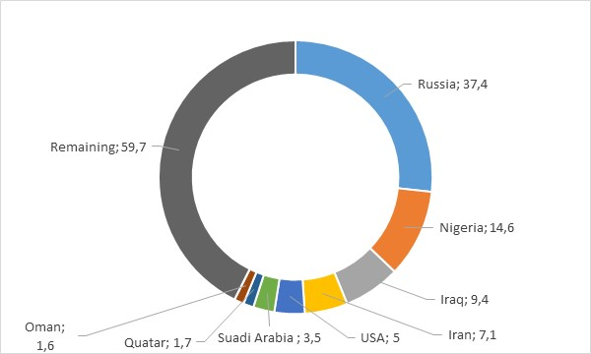
Abundant gas supply base in some distant places
Volumes of gas flared in bcm, 2011.

Slide 36
LNG technology
The first LNG plant was built in Arzew, Algeria in 1964 and had a capacity of 400 kT annually.
The first shipment to Japan, opening East Asian market for LNG occurred in 1969.
Durr Charles et al. LNG technology for the commercially minded. Gastech 2005.

Slide 37
LNG technology
LNG technology is based on chilling natural gas down to -160 C what reduces the volume by a factor of roughly 600. This volume reduction forms the key advantage for transportation over long distances especially where marine transportation can be used (where pipelines in turn become more expensive).
However, the low temperature creates a substantial disadvantage:
  Firstly reducing the temperature of the gas to -160 C requires energy. Typically about 10% of the natural gas delivered to a LNG plant must be burned to provide the energy needed for cooling down.
  Secondly the refrigeration machinery is expensive as low temperature of processing requires special materials.
  Thirdly LNG must be stored in tanks made of aluminum, stainless and high nickel steel, or other more expensive specialized materials. In case of natural gas pipelines operating at ambient temperature can be made of carbon steel materials.
Durr Charles et al. LNG technology for the commercially minded. Gastech 2005.

Slide 38
LNG Market Globalization
The globalization of natural gas is leading to product specification problems related to “gas interchangeability.”
Traditionally gas was produced for a local market to meet its respective specifications resulting from equipment and appliances designed for that local specification.
The key LNG markets: European, Pacific Rim, UK and US are characterized by wide differences in the specifications. This invoking interchangeability problem.
Typically the gas can come from two sources: associated with oil and non-associated. Associated gas has a high concentration of heavy components and must have propane and butane (also known as liquid petroleum gas, LPG). At some point gas has to be conditioned to final customers’ specifications. Although gas interchangeability is important from gas marketing and technology perspectives, the cost of providing interchangeability is relatively low.
It looks like the industry is heading in a direction of conditioning the gas at the receiving end. This provides the receiving terminal with flexibility on supply side. Durr Charles et al. LNG technology for the commercially minded. Gastech 2005.
The most fundamental obstacle for LNG growth is the high transportation costs. EIA estimates that liquefaction and forwarding costs from US Gulf Coast to Japan surpass 8 USD/MMBtu thus being twice more than purchasing cost at point of origin Houser, loc. 2454).

Slide 39
LNG trade globally
LNG trade in bcm equivalent below accounts for less than 10 % of natural gas consumption
It has been estimated that a LPG terminal with all infrastructure and tankers for
8,4 bcm/year would cost 4 bn USD. (Kandiyoti, p. 15)

Slide 40
Status of the us LNG plants
Magnalia
project
presentation

Slide 41
LNG capacity in Europe
Source
GLE NG

Slide 42
Klaipeda LNG Project
Designed for 4bcm annual
capacity to meet 100 % of
Lithuanian demand.
FSRU may function also as
LNG carrier.
Opened in Dec. 2014
Created by politics.

Slide 43
LPG on crossroads of crude and gas
LPG is derived either from crude-oil refining or from natural-gas production. At present, more than 60% of global LPG comes from natural gas processing plants.
LPG is generally refrigerated for large-scale bulk storage and seaborne transportation as a liquid, but it is transported and stored locally in pressurized tanks or bottles (cylinders) (WLPGA 2014).

Slide 44
LPG direct gasoline competitor?
Has more than 1,000 applications: apart from transportation, it is used in commercial business, industry, farming as well as for domestic heating and cooking.
By far the biggest consumer is chemical industry with 40 million tonnes per year in US and Saudi Arabia.
Personal vehicles is the best known and one of the fastest growing sectors, representing almost 9% and 22.87 million tonnes of global LPG consumption worldwide (2010). (WLPGA, 2014)

Slide 45
LPG global market
Total LPG production was 280 million tonnes and only 1/3 of that was traded internationally.
Asia-Pacific, North America and Middle East count as both producers and consumers with the former being net importer while the latter two running surpluses.
Shale gas revolution will impact LPG.

Slide 46
GTL technology
Historical background of crude oil substitutes based on gases
Description and key products of GTL technology
Competitive position of natural gas as feedstock for refinery business
Conclusions – Will gas substitute crude oil as a primary refining feedstock?

Slide 47
Fisher - Tropsch
Two German engineers Fisher and Tropsch successfully developed and patented the process based on a collection of chemical reactions that converts a mixture of carbon monoxide and hydrogen into liquid hydrocarbons in 1925.
The process was due to German military needs during the II World War . The first plants began operation in 1938, followed by eight other to reach maximum capacity of 570,000 th. Mg year of oil products equivalent, meeting up to 15% of total German needs.

Slide 48
1945 -2010 Period
After the II World War Fisher – Tropsch synthesis attracted an enormous amount of research and development effort to such extend that a special web-side named www.fischer-topsch.org was created with an aim to collect a comprehensive bibliography of literature, including books, journal articles, conference presentations and government reports as well as related patents.
The popularity of German achievements among academics for a long time had not been matched by their practical application.
The only country expressing a real interest in a development of Fischer Tropsch technology was Republic of South Africa (RSA) – a country boycotted widely due to its apartheid policy, having extensive coal resources and virtually no oil fields – therefore constituting ideal premises for the technology development. The company in charge for the effort to redevelop Fischer –Tropsch technology was Sasol whose first commercial plant was opened in 1952 in Sasolburg, 40 miles south of Johannesburg.

Slide 49
GTL REINVENTED
Operator | Location | Commencing year | Nameplate capacity (bbl/d) | Construction costs (USD 1 000 K)
Shell | Bintulu/Malasya | 1993 | 12,000 | 1,500
Sasol | Sasolburg/RSA | 1994 | 5,600 | n/a
Shell | Bintulu/Malasya | 2006 | 2,700 | n/a
Sasol/Chevron | Oryx/ | 2006 | 34,000 | 1,500
Shell | Pearl/ Qatar | 2011 | 140,000 | 20,000
Chevron | Escravos/Nigeria |  | 34,000 | 10,000
Source: Based on (EIA 2013, p. 9)
Three plants in the United States—in Lake Charles, Louisiana; Karns City, Pennsylvania; and Ashtabula, Ohio—are proposed. Of these, only the Lake Charles facility is a large-scale GTL plant.

Slide 50
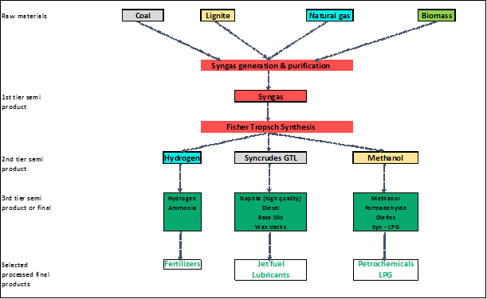
GTL value chain

Slide 51
GTL R&D
Research and development trends have to address the following challenges :
  capital cost reduction as, even by energy and refinery standards Fischer – Tropsch is a very capital intensive technology;
  expanding feedstock base through development of efficient least-cost gasification technologies for biomass, coal etc.;
  improving selectivity and catalyst lifetime.
GTL is still a nascent technology with potential for improvements

Slide 52
GTL R&D
Research and development trends have to address the following challenges :
  capital cost reduction as, even by energy and refinery standards Fischer – Tropsch is a very capital intensive technology;
  expanding feedstock base through development of efficient least-cost gasification technologies for biomass, coal etc.;
  improving selectivity and catalyst lifetime.
GTL is still a nascent technology with potential for improvements

Slide 53
GTL product slate
GTL exchanges 2 300 kT generic fuel for 1 500 kT Group III base oils and
additional 800 kT naphta

Slide 54
Pearl Value drivers
Share in total premium over the crude equivalent value (own estimates, k USD)

Slide 55
Pearl’s misfortunes
Cheap crude oil.
Cheap Group III base oils.
Attractive LNG.
Capital overspendings.
Not given for ever but second and third seem to be structural.

Slide 56
Pearl economics
Key economic factor based on own estimates (k USD)
Most probably for 2008 real Quatar prices were much below quotations adopted but from 2012 data are much more reliable

Slide 57
GTL alternative options
Mini plants:
  The University of Oxford came with a very active catalyst capable to work only with small quantities. In a similar environment the Pacific North West Laboratory in the USA invented a new type of chemical reactor. These two inventions seem to offer a clear advantage of small scale GTL installation oriented towards diesel productions.
  Claims are made that the cost of such product can be as low as 70 % of traditionally obtained diesel
Units built into existing refineries. Synergies:
  the potential availability of CO2,
  the use of a hydrocracker for upgrading (with potential of up to 75 % reduction in investment expenditures),
  the availability of existing utilities, offsites and services.

Slide 58
Conclusions
Full scale GTL natural gas based plants still under question mark.
Crude-gas spread a key factor determining GTL future.
GTL, as a nascent technology, still has potential for (revolutionary) improvements.
Three paths for GTL development are clear:
  Bio based GTL.
  Micro GTL.
  Refineries built-in GTL installations.

