Slide 1

Postgraduate studies –
European Refinery Business
Robert Uberman
for the Prof. Nela Vlahinić- Dizdarević’s Class
4th of April, 2014

Slide 2
Agenda
Overall view
Shifts on the demand side
Supply side evolution
Ownership (NOCs vs IOCs vs Independent)

Slide 3
Overall View
Refining as a mature business
Downstream as a poor cousin of upstream
Complexity of the refining business – joint product issue
Refining as an object of global oil policy

Slide 4
Falling demand for oil based products
Steve Cooper, „Crude Oil in Europe: Production, Trade and Refining Outllok”, WoodMckenzie, London, 2013, p. 14.

Slide 5
Evolution of the European demand side – cutting on edges
„Oil refining EU in 2020, with perspectives to 2030”, Concawe Report 1/2013, p. 21.

Slide 6
Evolution of the European demand side – gasoline to diesel
„Oil refining EU in 2020, with perspectives to 2030”, Concawe Report 1/2013, p. 19.

Slide 7
Evolution of the European demand side – gasoline to diesel
„The evolution of oil refining in Europe”, Concawe Review, vol. 22/1, 2013, p. 32.

Slide 8
Evolution of the European demand side – Fuel Quality
„The evolution of oil refining in Europe”, Concawe Review, vol. 22/1, 2013, p. 33.

Slide 9
Evolution of the crude supply around europe
Steve Cooper, „Crude Oil in Europe: Production, Trade and Refining Outllok”, WoodMckenzie, London, 2013, p. 12.

Slide 10
Refinery Process scheme

Slide 11
the European refineries – evolution of capacity
„The evolution of oil refining in Europe”, Concawe Review, vol. 22/1, 2013, p. 34.

Slide 12
refineries as energy consumers
„EU Refinery Energy Systems and Efficiency”, Concawe report no 3/2012, p. 4.

Slide 13
Natural gas as a key external energy source for refineries
„EU Refinery Energy Systems and Efficiency”, Concawe report no 3/2012, p. 11.

Slide 14
IOCs leaving downstream in Europe
Cuthbert, Leavens et el: „Developments in the International (…)”, Purvitz & Gertz report for UK Gov. June 2011, p. II/9.

Slide 15
Different ownership strategies
IOCs focusing on upstream (responsible for 60-90 % of their total profits)
NOCs from European countries expanding regionally with limited resources and political support
NOCs from China, Russia (and some other countries) expanding intensively with a global focus and strong political support
Independents trying to find niches and cut operating costs
Conglomerates (Essar Oil, Ineos) pursuing particular strategies, sometimes with government support

Slide 16
Conclusions
Refining in Europe - a mature business with declining demand
Key pressures, beyond falling demand:
  Diesel/Gasoline ratio forcing conversion up
  growing energy costs pushing conversion costs up
  both driven by EU policies
Majors leaving the business
Independents too weak to hold pressure
NOCs ready to step in

Slide 17
Postgraduate studies –
Role of Research and Development in the Oil and Gas Business
Robert Uberman
for the Prof. Nela Vlahinić- Dizdarević’s Class
4th of April, 2014

Slide 18
Agenda
Innovation in Upstream
Breakthrough downstream innovations
Research & Development
Oil is natural but money made on it are anthropogenic

Slide 19
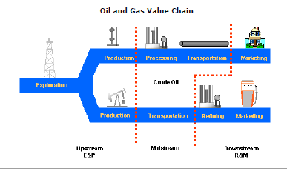
At first glance oil is a very simple business (…)
It’s, after all, about converting crude in a field into a fuel in an engine.

Slide 20
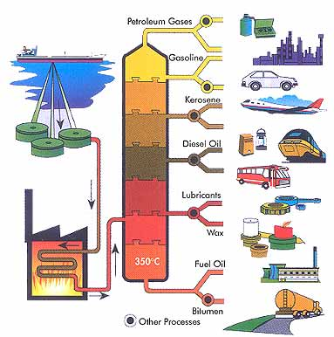
(…) But more deeper insight reviles some complexity (…)

Slide 21
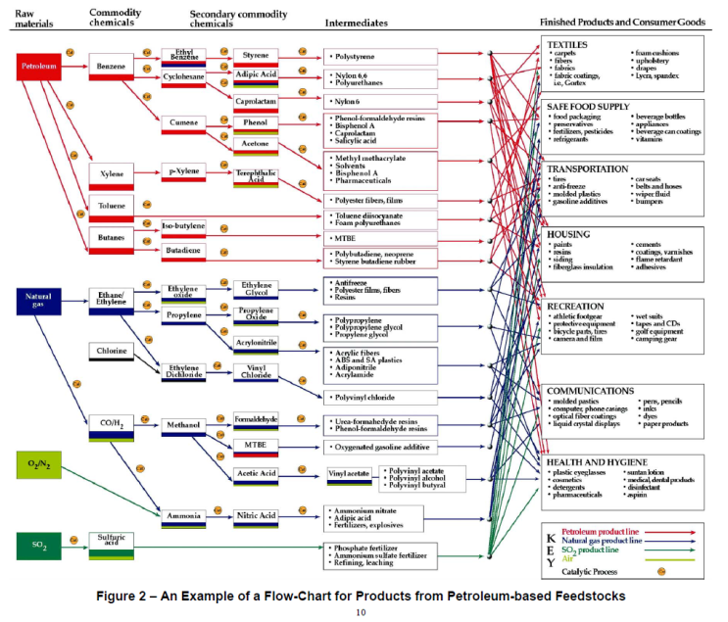
(…) Continuing down to that level
http://denmarkusmgreentour.wordpress.com/page/2/

Slide 22
R&D expenditures of Oil & Gas industry
http://www.oilgaspost.com/2013/05/21/top-40-oil-gas-companies-investment/
Service & independents
NOCs
IOCs

Slide 23
UPSTREAM Innovation
„For the upstream exploration and production (E&P) industry, the story of the last decade has been one of remarkable resilience, extraordinary innovation (…)”:
Increasing application of computing methods in seismic analyses
Horizontal drilling (initiated at commercial scale in 80s)
Sophisticated reservoir modelling and simulating
Hydraulic fracturing
Kibsgaard Paal, „A decade of upstream technology innovation” in: „Addressing Global Energy Challenges” World Petroleum Council, 2013, page 74.

Slide 24
Breakthrough downstream innovations: Hydrocracking
Hydrocracking (eg. Converting heavy, long hydrocarbon strings into short light ones) was first patented in Russia in 1881
Todays hydrocracking units are based on catalytic processes developed 1942-1947. These were first processes capable, at commercial scale, to change natural product structure as defined by crude
There would be no diesel revolution without hydrocracking

Slide 25
Breakthrough downstream innovations: GTL
Origins of GTL technology can be traced to pre II World War period.
Its first commercial debut after a long period in Shell’s Bintulu GTL plant in Malaysia in the early 1990s.
The Pearl Gas to Liquids (GTL) joint venture project of Shell and Qatar Petroleum - the world’s largest GTL plant and in fact one of the biggest refineries though with a natural gas as a feedstock, started 2011/2012
Consequences remain to be seen but definitely will be far going

Slide 26
Breakthrough downstream innovations: summary
Both Hydrocracking and GTL share some common properties:
  inward process orientation;
  customers needs definition developed without customers;
  no new products as a direct result;
  huge capital expenditures.

Slide 27
Customer related innovations
Often developed outside industry (petrochemicals by IG Farben, Dow, ICI)
Promoted by niche players
Not obviously linked to the refinery business
Relatively low volume
Possible if focus of R&D is redirected from internal processes to customer needs

Slide 28
Unattractiveness of Customer related innovations for oil majors
Low volumes:
  even if margins per unit are high overall margins are low;
  oil products are joint products – almost any change in one specification requires at least some alternations across the portfolio;
Cost of managing risk is very high since applications are made in businesses distant from Oil & Gas: mechanical industries, pharmacy and food, packaging.

Slide 29
Customer oriented innovation – vgo solvent extraction case
Traditionally part of VGO has been converted into two external products: base oil Gr. I and waxes;
Starting from 90s base oil Gr. I has been gradually replaced by Gr II and Gr III base oils which are derived from hydrocracking residue;
Official reason: Gr II and III have many functional advantages over Gr. I (which is true, by the way)
Real reason: the only way to increase Diesel output, all other things equal, is to divert VGO from solvent extraction to hydrocracking – consequently Gr I has to disappear;
Proof: the other external products obtained from the solvent extraction are waxes – they in turn can not be obtained from hydrocracking – customers got informed: you will have less waxes and they will be more expensive. Any problem with that. Oh it’s your problem !!!

Slide 30
Conclusions
R&D in case of Oil Majors is a supplementary internally oriented activity – such is this business
Product innovations are not on the top of priority lists
Majors are very good in networking and taking advantages of various alliances
NOCs have made heavy investments in R&D – results remain to be seen

